Slide 1
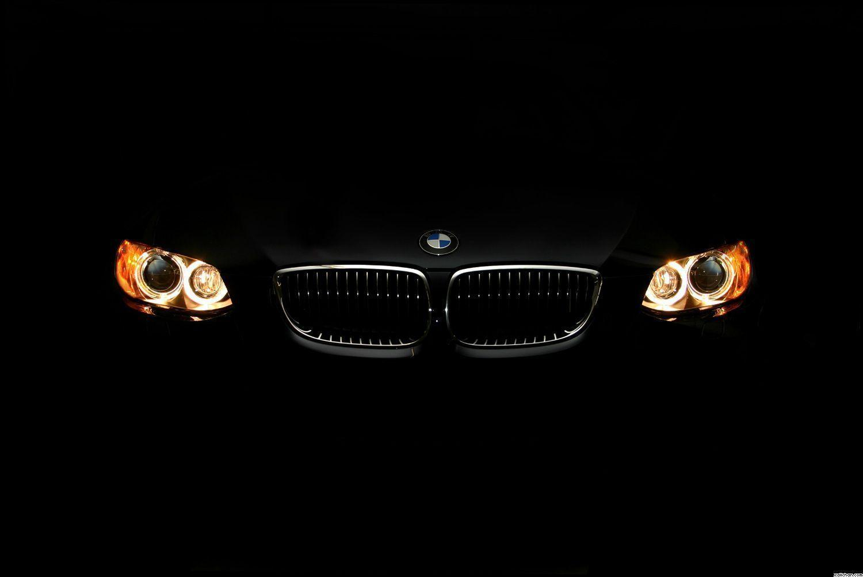
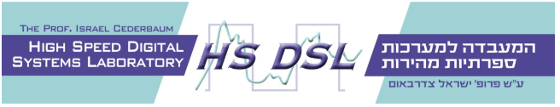

x
Infrastructure for BMW display unit
Project A
Developed by:
Daher Daher & Vivian Lawin
Supervisor:
Boaz Mizrachi

Slide 2
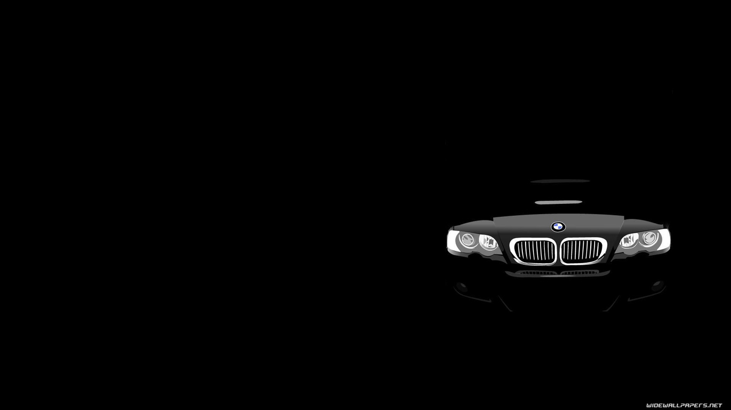
Motivation
In order to enhance and improve the driving experience in BMW cars in general (and BMW’s Autonomous cars in particular), drivers and car testers must understand and feel not only the condition of the environment and the traffic, but also the condition of the road.
Fraction
Humidity
Temperature and more.

Slide 3
Do we really need it?
Car testing is very essential, and the more the testing procedure is efficient the more the results are reliable, and time is saved.
Both advantages are highly desired in the era of new technology, and especially in the emerging field of AI and autonomous cars.
How about “safety”?

Slide 4
Feature List
Easy-to-use application.
Support multiple graphs (Up to 3 graphs at a time).
Choose different configurations (Resolution, Max value, Color…).
Support logging and data recording (internal memory file and in UI).
Time axis scaling.
Different appearance theme.

Slide 5
Main Concept
Two independent parts communicate one another in order to transfer data.
Transmitter - laptop which receives file of sensors data streams, parsing it and transmitting the data to the receiver.
Receiver - application installed in the car’s dashboard display system. On receiving data, the receiver parses, filters and enqueues the data for further processing by the application
Each of the above roles are independent and can be replaces and improved independently.

Slide 6
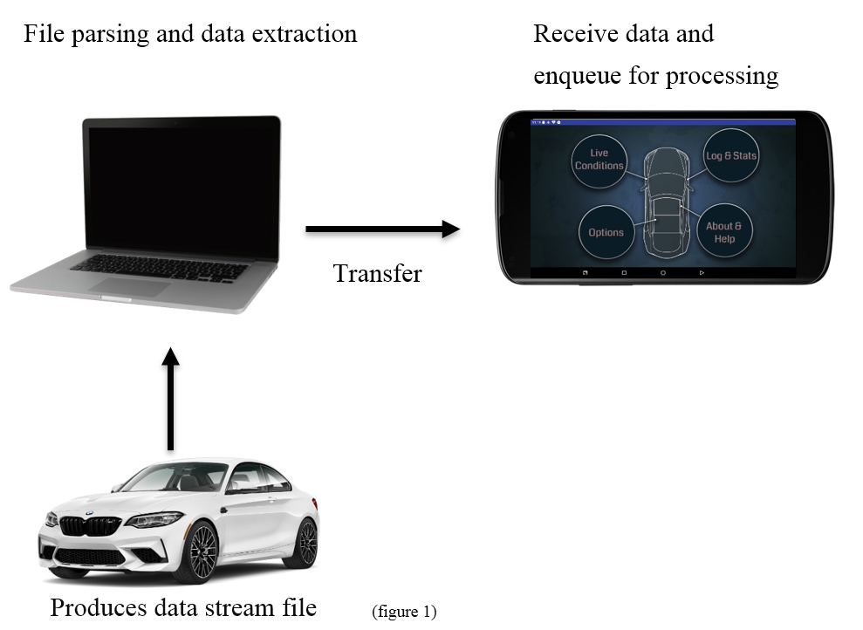
Main Concept
Two independent parts:
Transmitter – Java App
Receiver – Android App

Slide 7
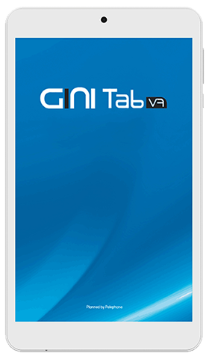
Technology - Display screen
Device: GINI Tab V7
Android Nougat 7
22.9% of all android users
Screen size: 7”
Screen resolution: 1280x800

Slide 8
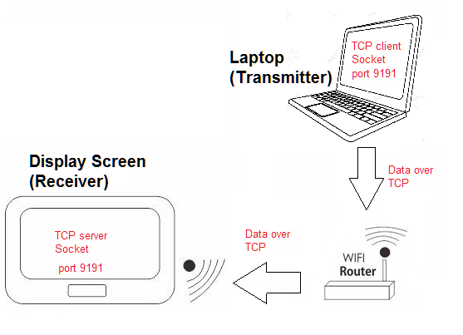
Technology – Data Transfer
How do the Transmitter and Receiver communicate?
TCP networking protocol
TCP Sockets.
Same WI-FI network
Receiver – Server
Transmitter – Client.
Open TCP sockets on the same port allowing them to communicate.

Slide 9
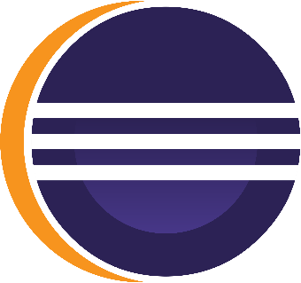

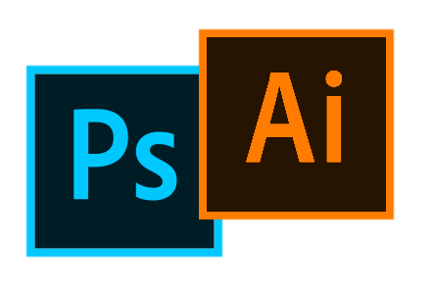
Technology – Development tools
Software & IDE’S
Android Studio IDE 3.3
Java over Windows OS
Eclipse Oxygen 4.7
Java over Windows OS
Graphics
Adobe Photoshop CC 2015
Adobe Illustrator CC 2015

Slide 10
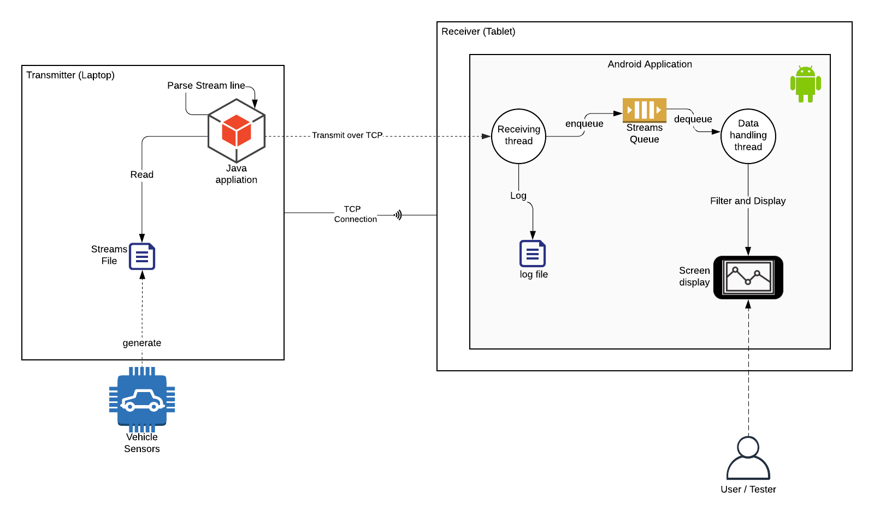
High Level Design

Slide 11
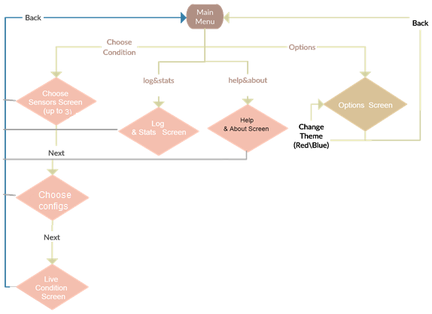
User Interface

Slide 12
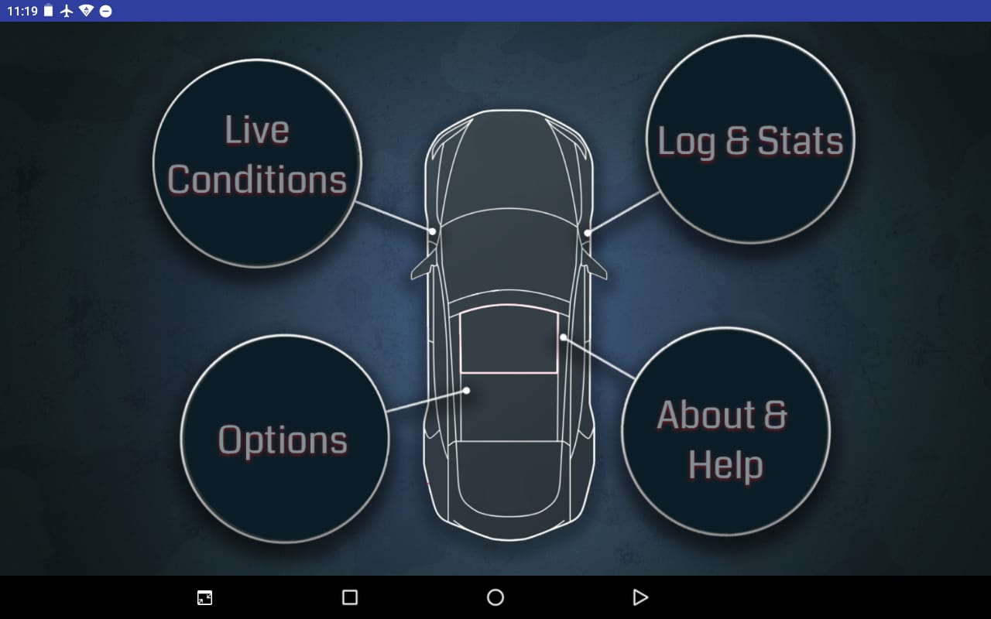
User Interface – Screens & Usage
Main Page
App’s home page
List of options

Slide 13
Screens & Usage –
Live Conditions

Slide 14
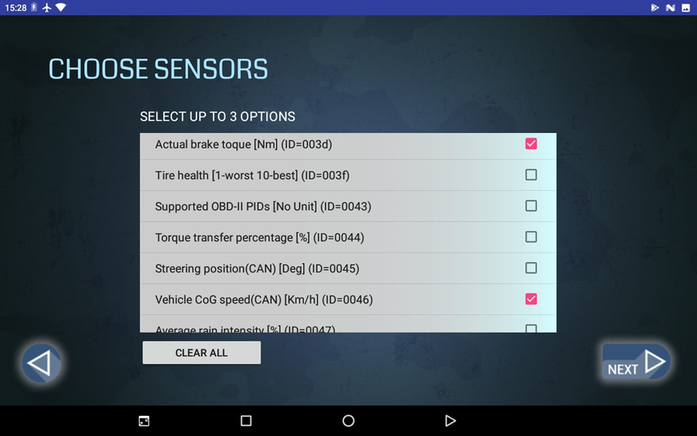
Live Conditions – Choose Sensors
Choosing which sensors to be displayed
User can choose up to 3 sensors to be shown at the same time.
Users cannot proceed to the next screen (using the next button) unless at least one option was chosen.

Slide 15
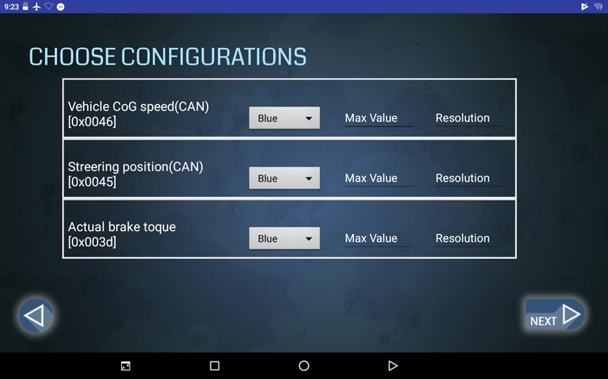
Live Conditions – Choose Configurations
Configurations according to user’s preferences.
Graph color
Max value
Resolution
If left empty, default configurations are used.

Slide 16
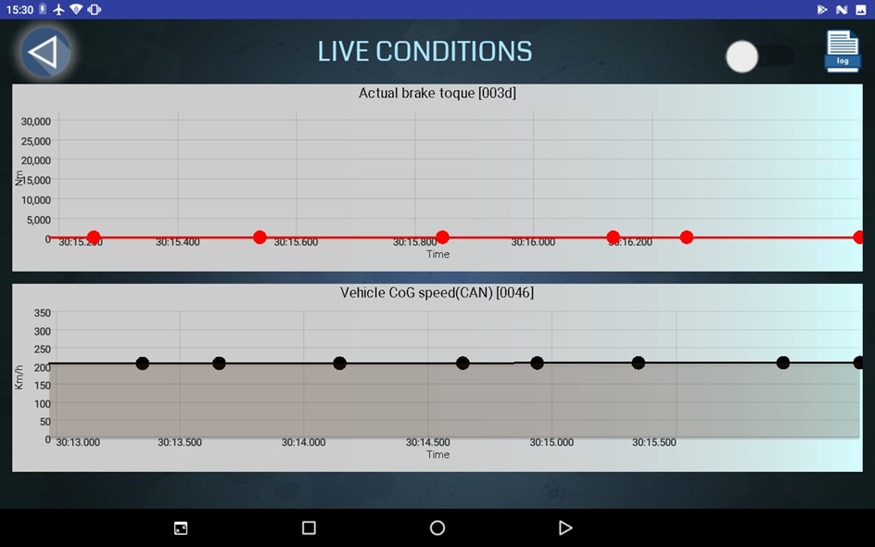
Live Conditions – Graphs
The actual live graphs.
On the top right-hand corner, the user can switch the logging option on/off.

Slide 17
Screens & Usage –
Options

Slide 18
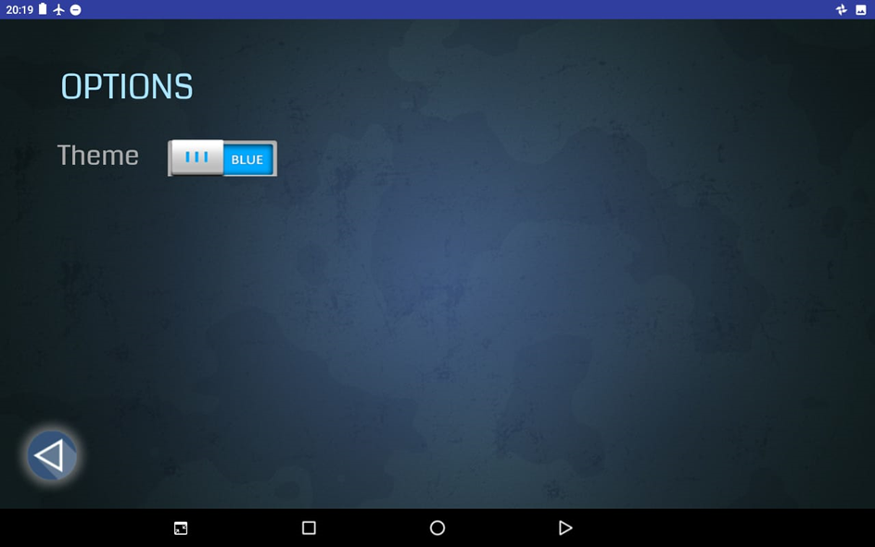
Options
Changing the theme of the app
Two options:
Red
Blue

Slide 19
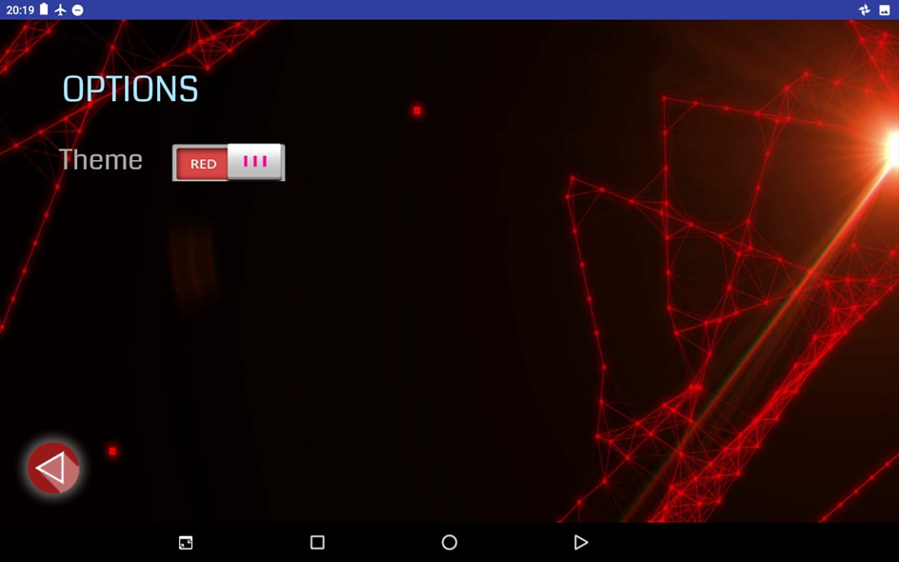
Options
Changing the theme of the app
Two options:
Red
Blue

Slide 20
Screens & Usage –
Log & Stats

Slide 21
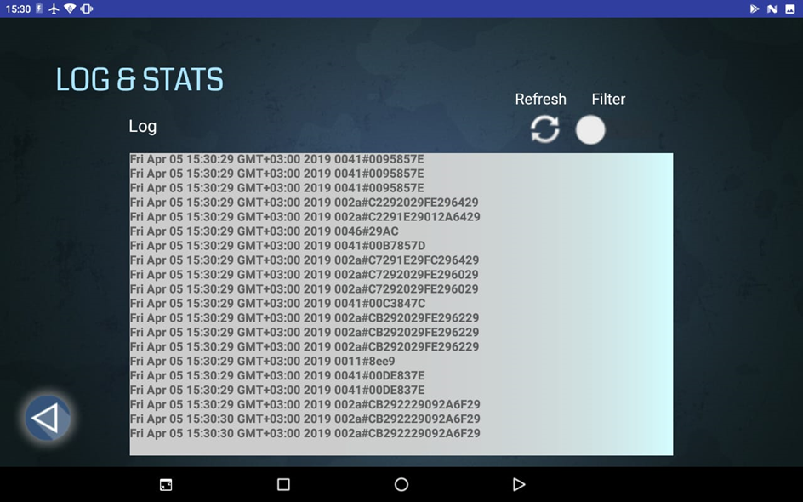
Log & Stats
View log recorded.
Filtering option according to the selected sensors.
Refresh button to update log view.

Slide 22
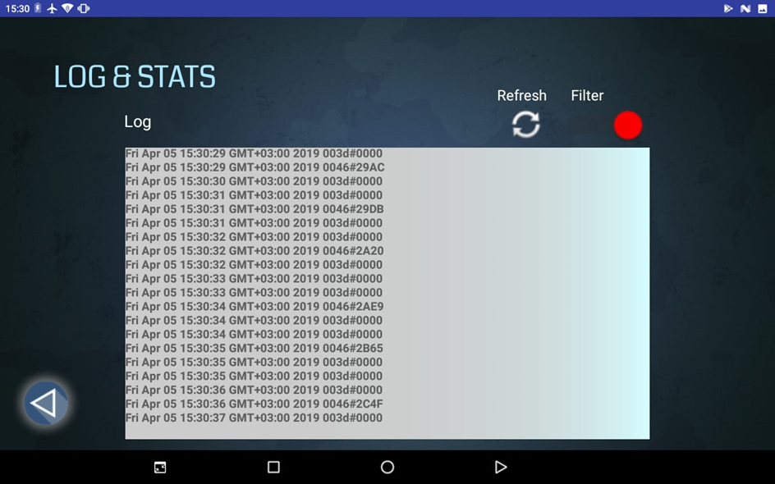
Log & Stats
View log recorded.
Filtering option according to the selected sensors.
Refresh button to update log view.

Slide 23
Screens & Usage –
Help & About

Slide 24
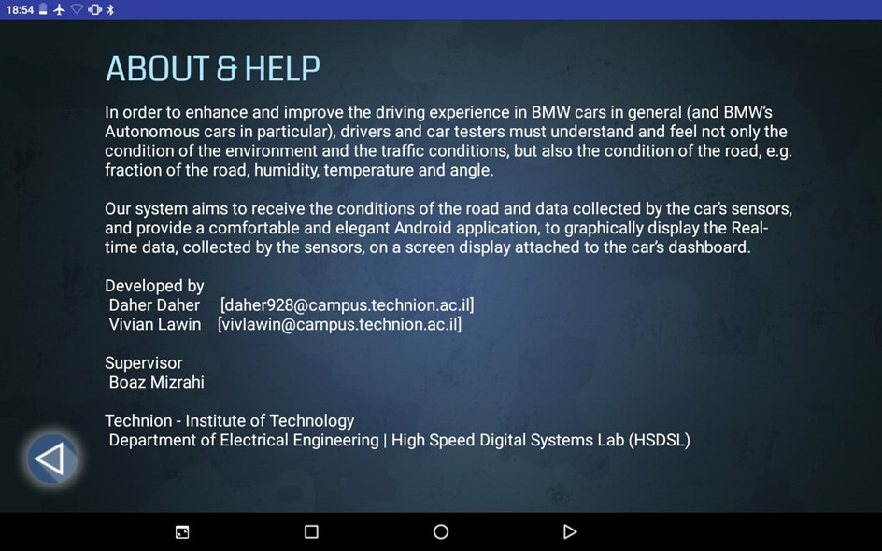
Help & About
A brief summary about the application.

Slide 25
Back-end - Transmitter
a Java application responsible for collecting the relevant data and transmitting them to the android application.
In order to do so, the Java Application sets up a connection over TCP
static final String androidId = "192.168.43.156";
static final int port = 9191;
static Socket socket;
static PrintWriter printwriter;
public static void setUpConnection(String Ip, int port){
socket = new Socket(Ip, port); // connect to server
printwriter = new PrintWriter(socket.getOutputStream(), true);
}

Slide 26
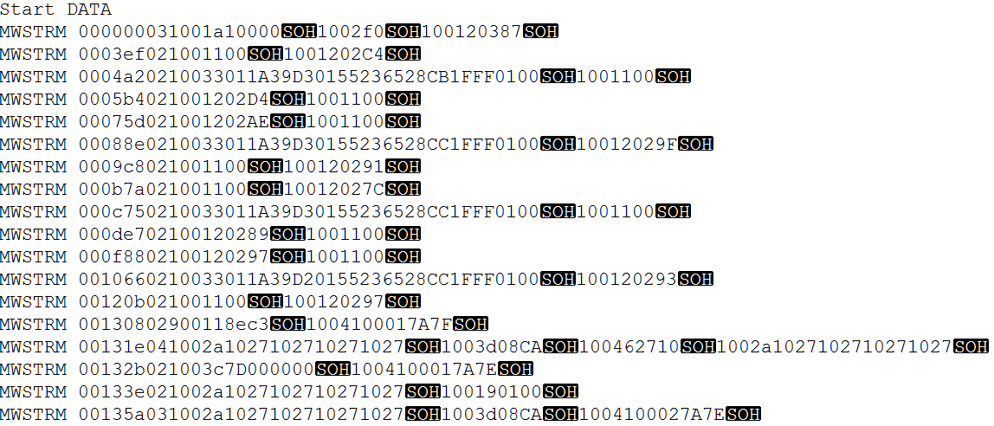
Back-end - Transmitter
Afterwards, the application proceeds to read the streams file written by the vehicle’s system.

Slide 27
Back-end - Transmitter
Each line is parsed into a DataSample object and each sample in the DataSample is sent over the socket as a <SensorId#SensorVal>.
public class DataSample {
public int timeStamp;
public int samplesCount;
public List<String> sampleIds;
public List<String> samplesData;
}
------------------------------------------
DataSample ds = parseLine(line);
for(int i = 0; i < ds.samplesCount; i++) {
String sampleId = ds.sampleIds.get(i);
String sampleVal = ds.samplesData.get(i);
send(sampleId + "#" + sampleVal);
}

Slide 28
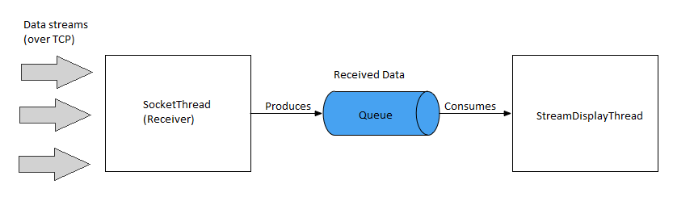
Back-end - Receiver
An Android application.
Composed of two main threads

Slide 29
Back-end - Receiver
SocketThread
actual receiving of the data
setting up the other endpoint of the connection set by the transmitter
listens on port 9191 to incoming data in the format <SensorId#Value>
on receiving data message, in case the logging option is set ON, it logs it into a log file (bmwLog)
enqueues the data into a Producer-Consumer queue.

Slide 30
Back-end - Receiver
isr = new InputStreamReader(socket.getInputStream());
br = new BufferedReader(isr);
while((message = br.readLine()) != null){
handler.post(new Runnable() {
@Override
public void run() {
Timestamp ts = new Timestamp(System.currentTimeMillis());
Date d1 = new Date(ts.getTime());
String logText = d1 + " " + message + "\n";
if (AppState.isLogActive){
FileOutputStream fileOutputStream =
context.openFileOutput("bmwLog",
Context.MODE_APPEND);
fileOutputStream.write(logText.getBytes());
}
}
});
AppState.queue.add(message);
}

Slide 31
Back-end - Receiver
StreamDisplayThread
handling the data received
dequeues the data from the producer-consumer queue
handles the filtering and updating the graphs

Slide 32
Back-end - Receiver
while (!AppState.queue.isEmpty() && running) {
final String s = AppState.queue.poll();
...
if (!AppState.selectedIds.contains(id)){ //FILTERING
return;
}else{
final double double_val = Integer.valueOf(val, 16);
int graph_idx = AppState.selectedIds.indexOf(id);
int sid = AppState.selectedIds.get(graph_idx);
Sensor currSensor = AppState.getSensorFromId(sid);
double resolution = currSensor.getConfig().getResolution();
double offset = currSensor.getOffset();
double final_val = double_val * resolution + offset;
switch(graph_idx){
//UPDATE RELEVANT GRAPH
}
}
}
});

Slide 33
CONCLUSIONS

Slide 34
What we gained
We learned and got to know basic android app development.
Data transfer to android application over TCP
Implementing a client – server communication, which is widely used and useful in todays technology.

Slide 35
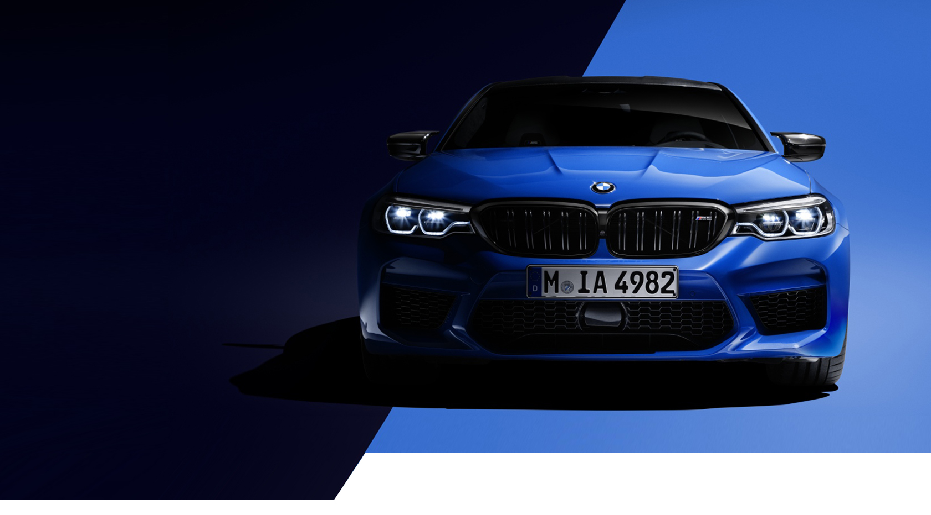
Thank You!
Buy me this☹

